Slide 1
http://www.vidyanidhi.com/
ketkiacharya.net@gmail.com
Ketki Acharya
From: SM VITA ATC of CDAC
9769201036
ketkiacharya.net@gmail.com

Slide 2
Traversing
.eq(index)
.eq(index) and .eq(-index)[-ve means from last]
.filter()
.first()
.last()
.not()
.has()
.find()
.end()
.endself()

Slide 3
.eq(index) and .eq(-index)[-ve means from last]
<ul>
<li>list item 1</li>
<li>list item 2</li>
<li>list item 3</li>
<li>list item 4</li>
<li>list item 5</li>
</ul>
We can apply this method to the set of list items:
1. $( "li" ).eq( 2 ).css( "background-color", "red" );
The result of this call is a red background for item 3. Note that the supplied index is zero-based, and refers to the position of the element within the jQuery object, not within the DOM tree.
Providing a negative number indicates a position starting from the end of the set, rather than the beginning. For example:
2. $( "li" ).eq( -2 ).css( "background-color", "red" );
This time list item 4 is turned red, since it is two from the end of the set.
<ul>
<li>list item 1</li>
<li>list item 2</li>
<li>list item 3</li>
<li>list item 4</li>
<li>list item 5</li>
</ul>
<ul>
<li>list item 1</li>
<li>list item 2</li>
<li>list item 3</li>
<li>list item 4</li>
<li>list item 5</li>
</ul>

Slide 4
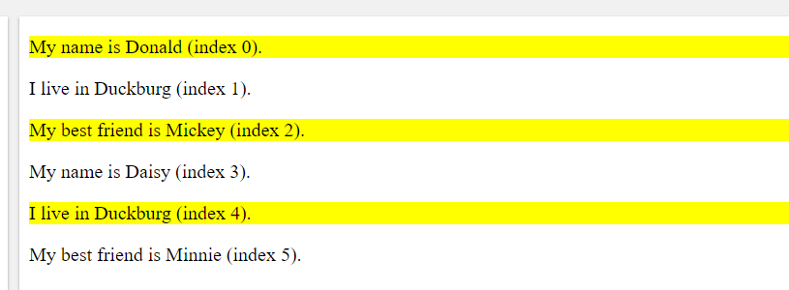
.filter()
$(selector).filter(criteria,function(index))
The filter() method returns elements that match a certain criteria.
This method lets you specify a criteria. Elements that do not match the criteria are removed from the selection, and those that match will be returned.
This method is often used to narrow down the search for an element in a group of selected elements.
$(document).ready(function(){
$("p").filter(":even").css("background-color", "yellow");
});
<p>My name is Donald (index 0).</p>
<p>I live in Duckburg (index 1).</p>
<p>My best friend is Mickey (index 2).</p>
<p>My name is Daisy (index 3).</p>
<p>I live in Duckburg (index 4).</p>
<p>My best friend is Minnie (index 5).</p>

Slide 5
Filter() with function
$(document).ready(function() {
$( "li" ).filter(function( index ) {
return $("strong",this).length === 1;
}).css( "background-color", "red" );}
<ul>
<li><strong>list</strong> item 1 - one strong tag</li>
<li><strong>list</strong> item 1 <strong>2 strong tag</strong> -
two <span>strong tags</span></li>
<li>list item 3</li>
<li>list item 4</li>
<li>list item 5</li>
<li>list item 6</li>
</ul>

Slide 6
First-last-not-has
<p> para 1</p>
<p> para<span> 2</span></p>
<p id="nm"> para 3</p>
<p> para 4</p>
$(document).ready(function() {
var a= $("p").first().text();
var b= $("p").last().text();
var all= $("p").not("#nm").text();
var s=$('p').has('span').text();
});
<p> para 1</p>
<p> para<span> 2</span></p>
<p> para 4</p>

Slide 7
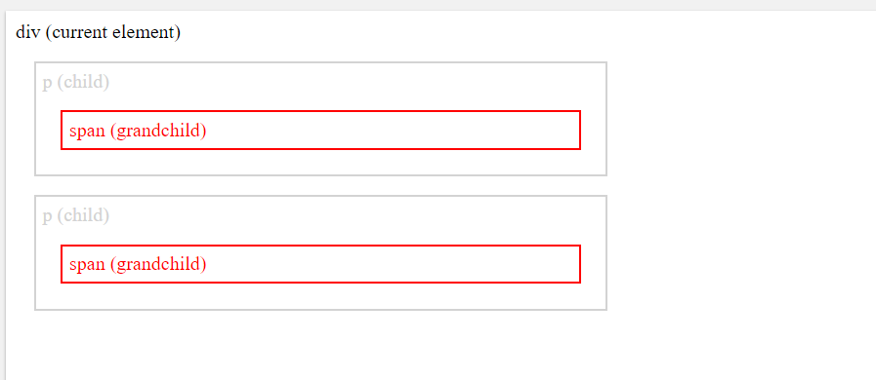
Find():method returns descendant elements of the selected element. A descendant is a child, grandchild, great-grandchild, and so on.
The DOM tree: This method traverse downwards along descendants of DOM elements, all the way down to the last descendant.
<div class="descendants" style="width:500px;">div (current element)
<p>p (child)
<span>span (grandchild)</span>
</p>
<p>p (child)
<span>span (grandchild)</span>
</p>
</div>
<style>
.descendants *{
display: block;
border: 2px solid lightgrey;
color: lightgrey;
padding: 5px;
margin: 15px;
}
</style>
$(document).ready(function() {
$('div').find('span').css('color',"red");
});

Slide 8
end()
$(document).ready(function() {
$('ul.first').find('.foo').css('background-color', 'red')
.end().find('.bar').css('background-color', 'green');
});
end() will take you back ie to parent.
<ul class="first">
<li class="foo">list item 1</li>
<li>list item 2</li>
<li class="bar">list item 3</li>
</ul>
<ul class="second">
<li class="foo">list item 1</li>
<li>list item 2</li>
<li class="bar">list item 3</li>
</ul>

Slide 9
andself()
.background { background:yellow; }
$(document).ready(function() {
$("div").find("p").andSelf().addClass("background ");
});
<div>data
<p>First Paragraph</p>
<p>Second Paragraph</p>
</div>
andSelf() will include effects on div tag also.
If you write
$("div").find("p").addClass("background ");
It
<div>data
<p>First Paragraph</p>
<p>Second Paragraph</p>
</div>

Slide 10
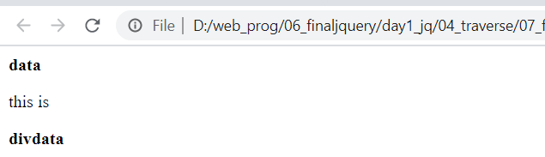
.contents()
.contents(): Get the children of each element in the set of matched elements, including text nodes.
$(document).ready(function() {
alert($('.container').contents().text());
$('.container').contents().filter(function() {
alert(this.nodeValue); //this refer to current object
return this.nodeType == 3;
}).wrap("<b></b>");
});
Data====text node [nodeType=3]
<p> this is</p>
Div data===text node
<div class="container">data<p>this is </p>divdata</div>

Slide 11
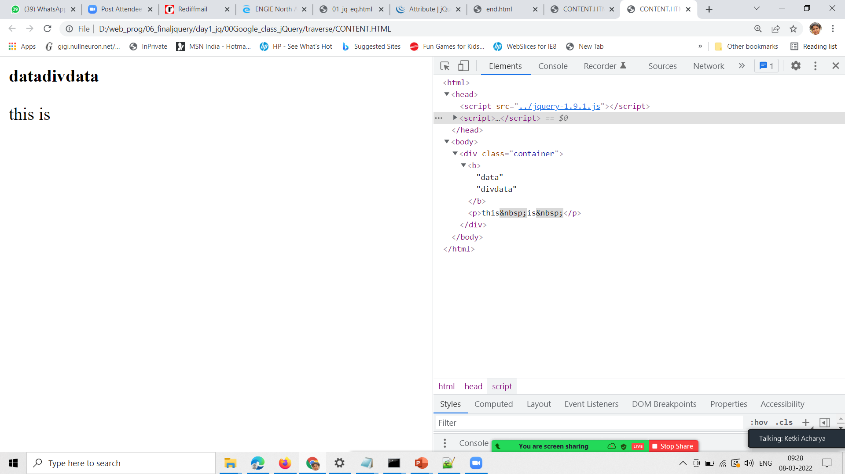
.contents()
.contents(): Get the children of each element in the set of matched elements, including text nodes.
$(document).ready(function() {
alert($('.container').contents().text());
$('.container').contents().filter(function() {
alert(this.nodeValue); //this refer to current object
return this.nodeType == 3;
}).wrapAll("<b></b>");
});
Data====text node [nodeType=3]
<p> this is</p>
Div data===text node
<div class="container">data<p>this is </p>divdata</div>

